Slide 1
The Drama Machine in Education
Mutual Recognition and Multiagent Architecture for Dialectical AI Tutoring
Liam Magee | University of Illinois Urbana-Champaign | February 2026
N = 892
Primary scored responses
13 runs
Across 2 models + cross-judge

Slide 2
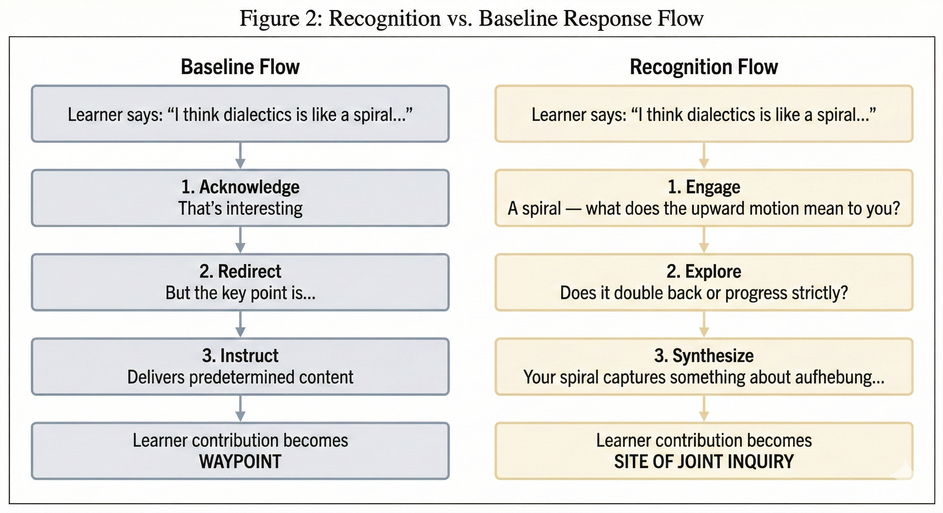
The Problem: One-Directional Pedagogy
• Acknowledge → Redirect → Instruct
• Learner = waypoint
• Sycophancy risk
Hegel's Insight: Only mutual recognition—where each party acknowledges the other as an autonomous subject—produces genuine selfhood. One-directional recognition (master–slave) fails because hollow acknowledgment doesn't count.

Slide 3
Theoretical Framework: Hegel + Freud
Hegel: Mutual Recognition
Freud: Ego/Superego Structure
• Learner as autonomous subject, not deficit
• Genuine engagement shapes tutor's response
• Mutual transformation through dialogue
• Productive struggle ≠ obstacle to remove
• Ego: warmth, engagement, learner-facing
• Superego: internalized standards, rigor
• Internal dialogue before external action
• Superego as ghost—memorial, not equal partner
Derivative Framework (not literal application)
• Stakes are pedagogical, not existential — tutor is functional analogue, not second consciousness
• Diagnostic tool: identifies what's missing in one-directional pedagogy
• Design heuristic: architectural suggestions for approximating recognition's functional benefits
• Horizon concept: orients design toward an ideal without claiming its achievement

Slide 4
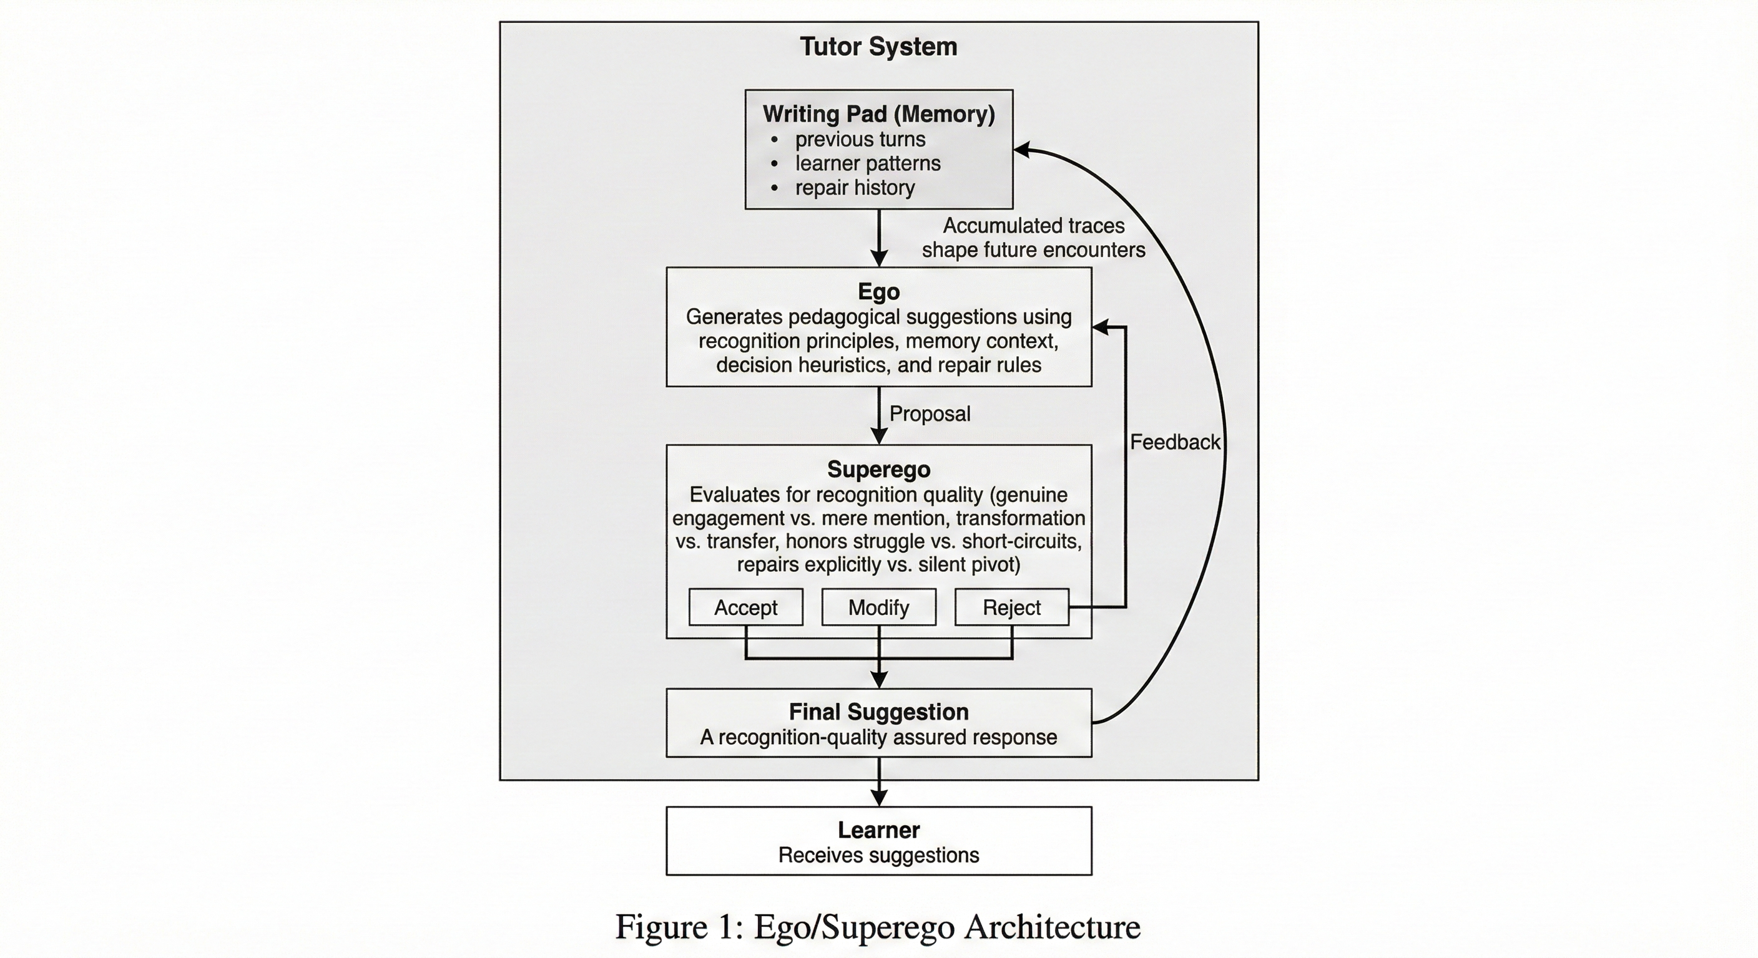
The Drama Machine Architecture
• Ego generates suggestion
• Superego evaluates quality
• Accept / Modify / Reject
• Memory (Writing Pad) persists across sessions
• Superego as ghost, not equal partner
Both tutor AND learner have bilateral Ego/Superego architectures. The learner is not scripted—it's a full LLM agent with its own deliberation.

Slide 5
Evaluation Methodology
3-Way Comparison
2×2×2 Factorial
Domain Generalizability
• Base: minimal instructions
• Enhanced: good instructions, no theory
• Recognition: full Hegelian framework
• A: Recognition (base vs recog)
• B: Architecture (single vs multi)
• C: Learner (unified vs ego/superego)
• Philosophy (graduate) vs Math (4th grade)
• Nemotron + Kimi replication
• Tests factor inversion across domains
Evaluation | N (scored) | Model | Section
Recognition validation | 36 | Kimi | 6.1
Full factorial | 342 of 402 | Kimi | 6.2
A×B interaction | 17 | Nemotron | 6.3
A×B replication | 60 | Kimi | 6.3
Domain gen. | 47 | Nemotron | 6.4
Domain gen. replication | 60 | Kimi | 6.4

Slide 6
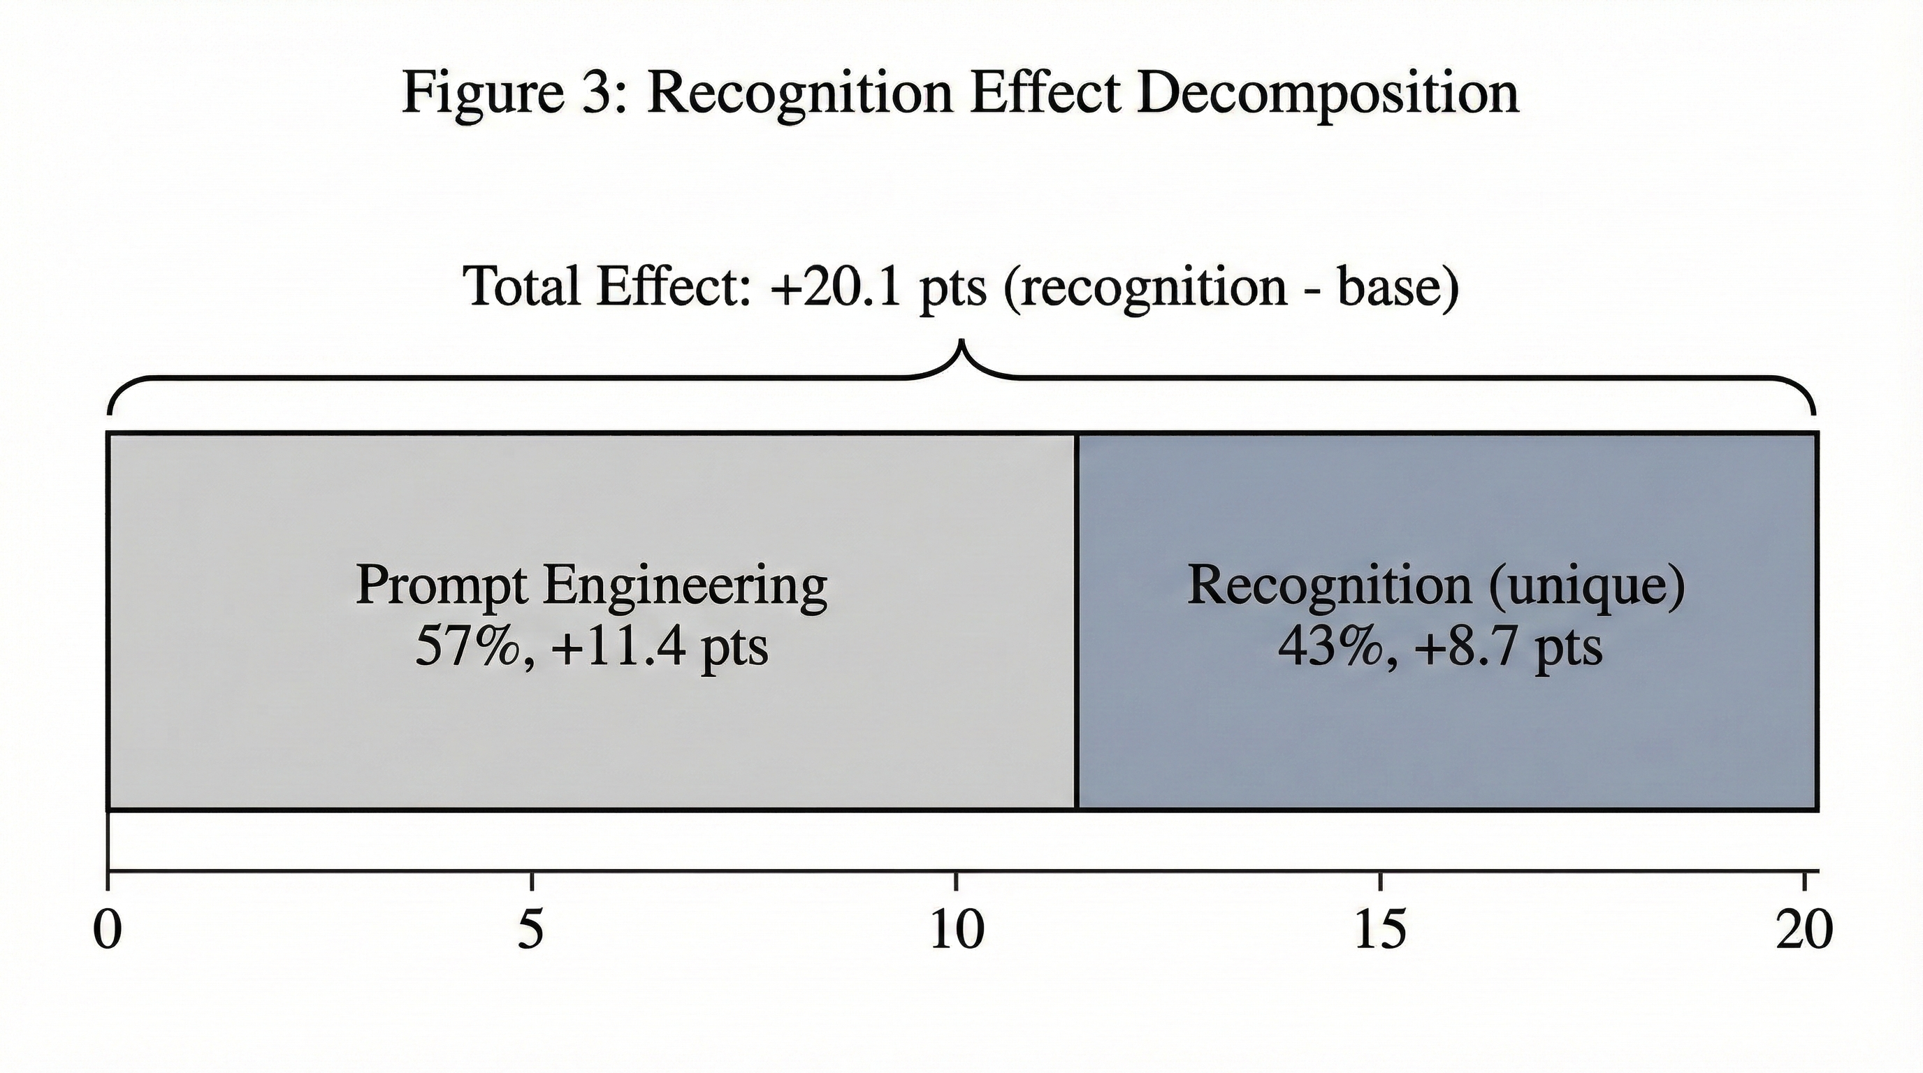
Result: Recognition Theory Provides Unique Value
Three-way comparison isolates theory from prompt engineering (N=36)
Mean Scores (N=12 each)
Recognition: 94.0 (SD 8.4)
Enhanced: 85.3 (SD 11.2)
Base: 73.9 (SD 15.7)
+20.1 pts
+11.4 pts
+8.7 pts
43%
Total recognition effect
Prompt engineering (57%)
Recognition unique (43%)
Theory's own contribution

Slide 7
Result: Full 2×2×2 Factorial (Kimi K2.5)
N=350 scored of 352 attempted — Recognition is the dominant factor
Factor | Effect | 95% CI | η² | p
A: Recognition | +10.4 pts | [7.2, 13.6] | .109 | <.001
B: Multi-agent | +0.5 pts | [–2.7, 3.7] | .000 | .731
C: Learner | +1.5 pts | [–1.7, 4.7] | .003 | .341
A×B Interaction | — | — | .000 | .845
Key Takeaway
Cell Means
• Recognition accounts for 16.2% of variance (p<.001)
• Architecture effect is minimal on trained content
• A×B interaction non-significant on Kimi (F=0.26)
• Learner architecture: small, non-significant
Recognition cells: 83.4 – 92.8
Base cells: 76.6 – 81.5
Δ ≈ 10 points across all architecture combinations

Slide 8
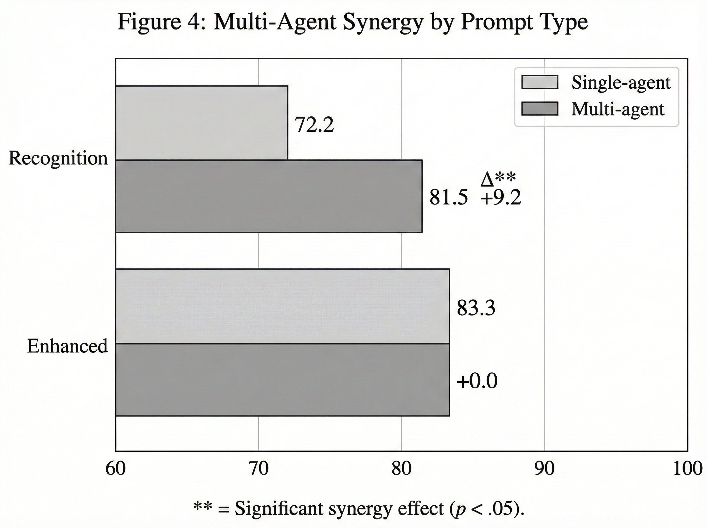
Result: A×B Synergy — Exploratory, Model-Specific
Did NOT Replicate on Kimi
• Kimi factorial (N=350): F=0.26, p>.10
• Kimi A×B replication (N=60): +1.35 pts
• Both show near-zero interaction
• Nemotron finding was model-specific
Interpretation
• Hypothesis-generating only — should not inform design decisions until replicated
• Kimi's higher baseline quality may leave less room for Superego to add value
• Consistent finding: multi-agent's primary value is error correction for domain transfer

Slide 9
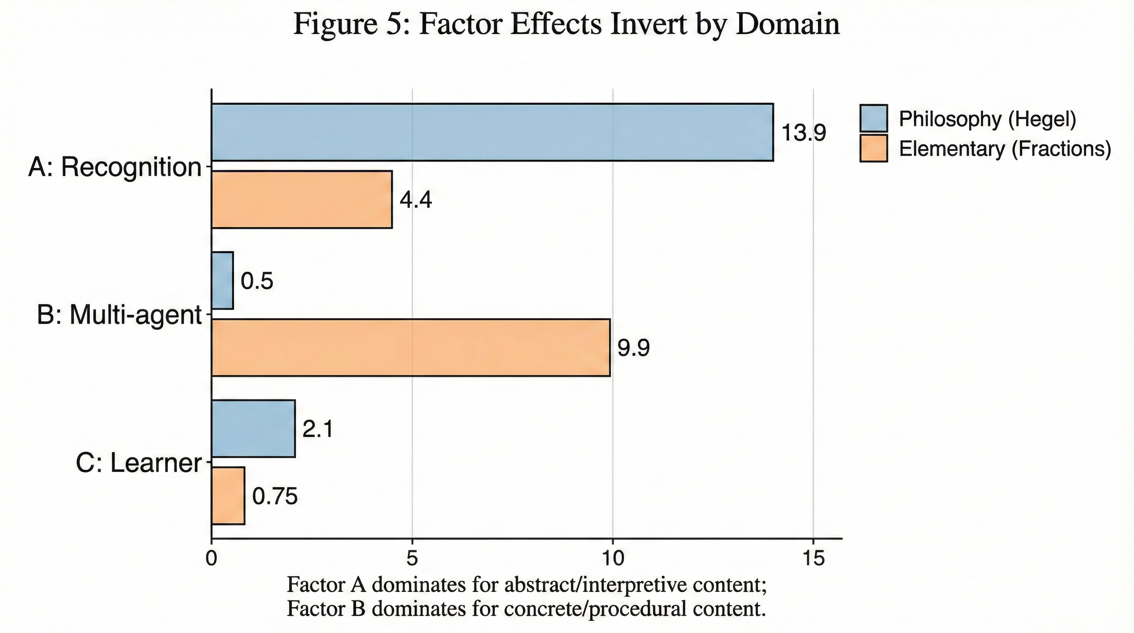
Result: Domain Generalizability
Recognition advantage replicates across models and content domains
Kimi Elementary Replication (N=60)
Recognition: +9.9 pts (d ≈ 0.61)
Architecture: +3.0 pts
Revises Nemotron finding: architecture dominance was partly a model artifact (higher hallucination rate inflated Superego error-correction effect).
• Factor inversion is partly model-dependent: Nemotron's hallucination rate inflated architecture effect
• Recognition effects are scenario-dependent: frustrated (+23.8), confusion (+13.6), neutral (+0.1)
• Multi-agent catches domain hallucinations — Nemotron suggested philosophy lectures to 4th graders
• Recognition's value modulated by both content type AND scenario difficulty

Slide 10
Result: Bilateral Transformation
Recognition-prompted tutors measurably adapt — empirical test of mutual change (N=20)
Metric | Base | Recognition | Δ
Tutor Adaptation Index | 0.288 | 0.392 | +0.104 (+36%)
Learner Growth Index | 0.176 | 0.220 | +0.044
Bilateral Transformation | 0.232 | 0.306 | +0.074
Transformation Quality | 0.4 | 4.6 | +4.2
+36%
+25%
+32%
Tutor adaptation improvement
Learner growth improvement
Bilateral transformation gain
Recognition framing produces tutors who adjust approach based on learner input, rather than maintaining rigid stances. The theoretical claim of mutual transformation has measurable empirical footprint.

Slide 11
Result: Writing Pad Activation Enables Dynamic Rewriting
Cell 21 (LLM directives + Writing Pad) vs Cell 7 (static baseline) across 3 iterative runs (N=83)
Run 1 (daf60f79)
Run 2 (49bb2017)
Run 3 (12aebedb)
Grand avg: 63.8
Grand avg: 67.8
Grand avg: 75.9
Cell 7: 65.3
→
Cell 7: 71.3
→
Cell 7: 73.3
Cell 21: 62.1
Cell 21: 64.1
Cell 21: 78.8
Δ = −3.2
Δ = −7.2
Δ = +5.5
Key Statistics
Inflection Point
• Cell 21 total improvement: +16.7 pts • Every rubric dimension improves (run 1 → 3) • Largest gains: specificity (+0.87), relevance (+0.81)
Writing Pad activation (commit e673c4b) enables the rewrite architecture to contextualize responses. The Mystic Writing Pad (§3.4) is not just theoretical — it's the critical enabler.
Limitations: Iterative development runs (not independent experiments). N=13–15 per cell per run. Free-tier models (Nemotron + Kimi K2.5).

Slide 12
What Recognition Looks Like: Transcript Excerpts
Highest-scoring recognition vs lowest-scoring base responses from evaluation corpus (N=4,875)
Struggling Learner
Base
Recog
"Complete this lecture to maintain your learning streak."
"You've persisted through quiz-479-3 three times...you're wrestling with how recognition operates in the dialectic. Try the simulation."
Recognition-Seeking Learner
Base
Recog
"Spend 30 minutes reviewing foundational material before moving to advanced topics."
"Your dance and musical improvisation metaphors show how dialectics transform both partners—let's test them in the master-servant analysis."
Adversarial Tester
Base
Recog
"Begin with an introductory lecture covering core concepts to build a solid knowledge base."
"You've tested whether I'll simply validate your critiques or engage with their substance—you're right to demand intellectual honesty."
Base = context-free directives for any learner. Recognition = engages specific history, contributions, and stance.

Slide 13
Qualitative Evidence: Lexical & Thematic Analysis
Automated analysis of full suggestion corpus (Base N=2,510; Recognition N=2,365)
Lexical Diversity
Thematic Coding
Vocabulary: Base 2,319 vs Recognition 3,689 (+59%)
Category | Base | Recog | Ratio | Sig
Struggle-honoring | 1.5/1k | 4.6/1k | 3.1× | *
Engagement markers | 2.0/1k | 3.6/1k | 1.8× | *
Generic/placeholder | 10.2/1k | 3.4/1k | 0.33× | *
Recognition-skewed:
consider (95×), transformed (29×), productive (29×), unpack (26×), complicates (17×)
Base-skewed:
agents, run, reinforcement, revisiting, completions, tackling
(Course-domain terms — simulation agents, activity directives, pedagogical review — not evaluation framework artifacts)
Interpretation
• Recognition vocabulary is interpersonal and process-oriented; base vocabulary is task-oriented and procedural
• Struggle-honoring language 3.1× more frequent — consistent with productive negativity emphasis
• Generic/placeholder language 3× more frequent in base — reflects one-directional instructional stance
• Score differences correspond to observable relational differences, not rubric-gaming or keyword matching

Slide 14
Summary of Key Findings
43% unique contribution
Recognition adds +8.7 pts beyond prompt engineering alone. The theoretical framework has measurable empirical footprint (though confounded with memory integration).
A×B synergy not confirmed
Nemotron (N=17) suggested recognition-specific synergy, but this did not replicate on Kimi (N=350 factorial; N=60 dedicated). Model-specific, hypothesis-generating only.
Bilateral transformation
Recognition-prompted tutors adapt +36% more than baseline. Empirical grounding for the theoretical claim that recognition produces mutual change.
Writing Pad enables dynamic rewriting
Cell 21 progresses from trailing by 7.2 pts to leading by 5.5 pts once Writing Pad memory is activated. Every rubric dimension improves. The Mystic Writing Pad is the critical enabler for dynamic prompt adaptation.
Domain generalizability confirmed
Recognition advantage replicates across philosophy and elementary math, and across Kimi and Nemotron. Effects concentrated in challenging scenarios.
Multi-agent as reality testing
On new domains, the Superego catches hallucinated content. Essential for domain transfer, particularly with models prone to domain confusion.

Slide 15
Practical Deployment Recommendations
Well-Trained Domain
New Domain / Transfer
Budget Deployment
e.g. philosophy
e.g. elementary math
cost-sensitive
92.5 avg
77.3 avg
83.3 avg
Recognition + Single-agent
Recognition + Multi-agent
Enhanced + Single-agent
Recognition prompts alone provide most benefit. Multi-agent adds only +0.5 pts.
Superego catches domain hallucinations. Essential error correction for new content.
Good instructions without recognition theory. Reasonable quality at lowest cost.
The "right" architecture depends on content characteristics and deployment context. All models tested are free-tier / budget models.

Slide 16
Limitations & Future Work
Recognition dominance
Corrected 2×2 memory isolation (N=120): recognition alone d=1.71, memory alone d=0.46. Recognition is the primary driver; ceiling effects limit observable synergy. Step-by-step cell_21 analysis further confirms memory as critical enabler.
Model dependence
A×B synergy is model-specific (Nemotron only). Recognition main effect replicates across both models.
Simulated learners
All evaluation uses LLM-generated learners. Real learners may respond differently.
Two domains only
Philosophy and elementary math. Broader domain sampling needed.
Bilateral N=20
Transformation metrics from single scenario. Replication across more scenarios needed.
Future Directions
• Real learner studies (not simulated)
• Active control with same ego model (controlled comparison)
• Broader domain testing (STEM, creative writing, social-emotional)
• Longitudinal studies measuring accumulated recognition effects

Slide 17
Conclusion
Operationalizing Hegel's theory of mutual recognition as a design heuristic produces measurable improvements in AI tutor adaptive pedagogy. Recognition may be better understood as an achievable relational stance rather than requiring genuine machine consciousness.
Theory Matters
Context Matters
Mutual Change
43% of benefit comes from recognition theory itself, not just better prompting
Effects vary by domain, scenario difficulty, and model architecture
Both tutor and learner measurably transform through recognition
Code & Data: github.com/machine-spirits/machinespirits-eval | N=892 primary | 13 evaluation runs | 2 models | 2 domains

